Slide 1

CS345:
CRYPTOGRAPHY & NETWORK SECURITY
Encryption – Decryption System
Prepared By:
Vikas Marwadi
Tirth Bharatiya
Guided By:
Asst. Prof. Khushi Patel

Slide 2
Contents
What is RSA and Deffie - Helleman algorithm?
Project Definition
Features of project
Working of application
Flowchart
Future Scope
References

Slide 3
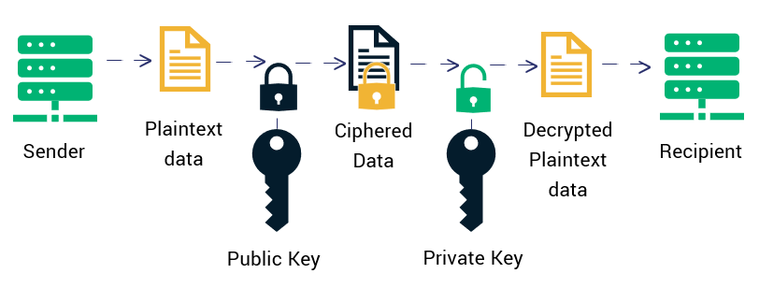
RSA Algorithm
RSA is a public-key cryptosystem that is widely used for secure data transmission.
It works on two different keys: private key and public key.

Slide 4
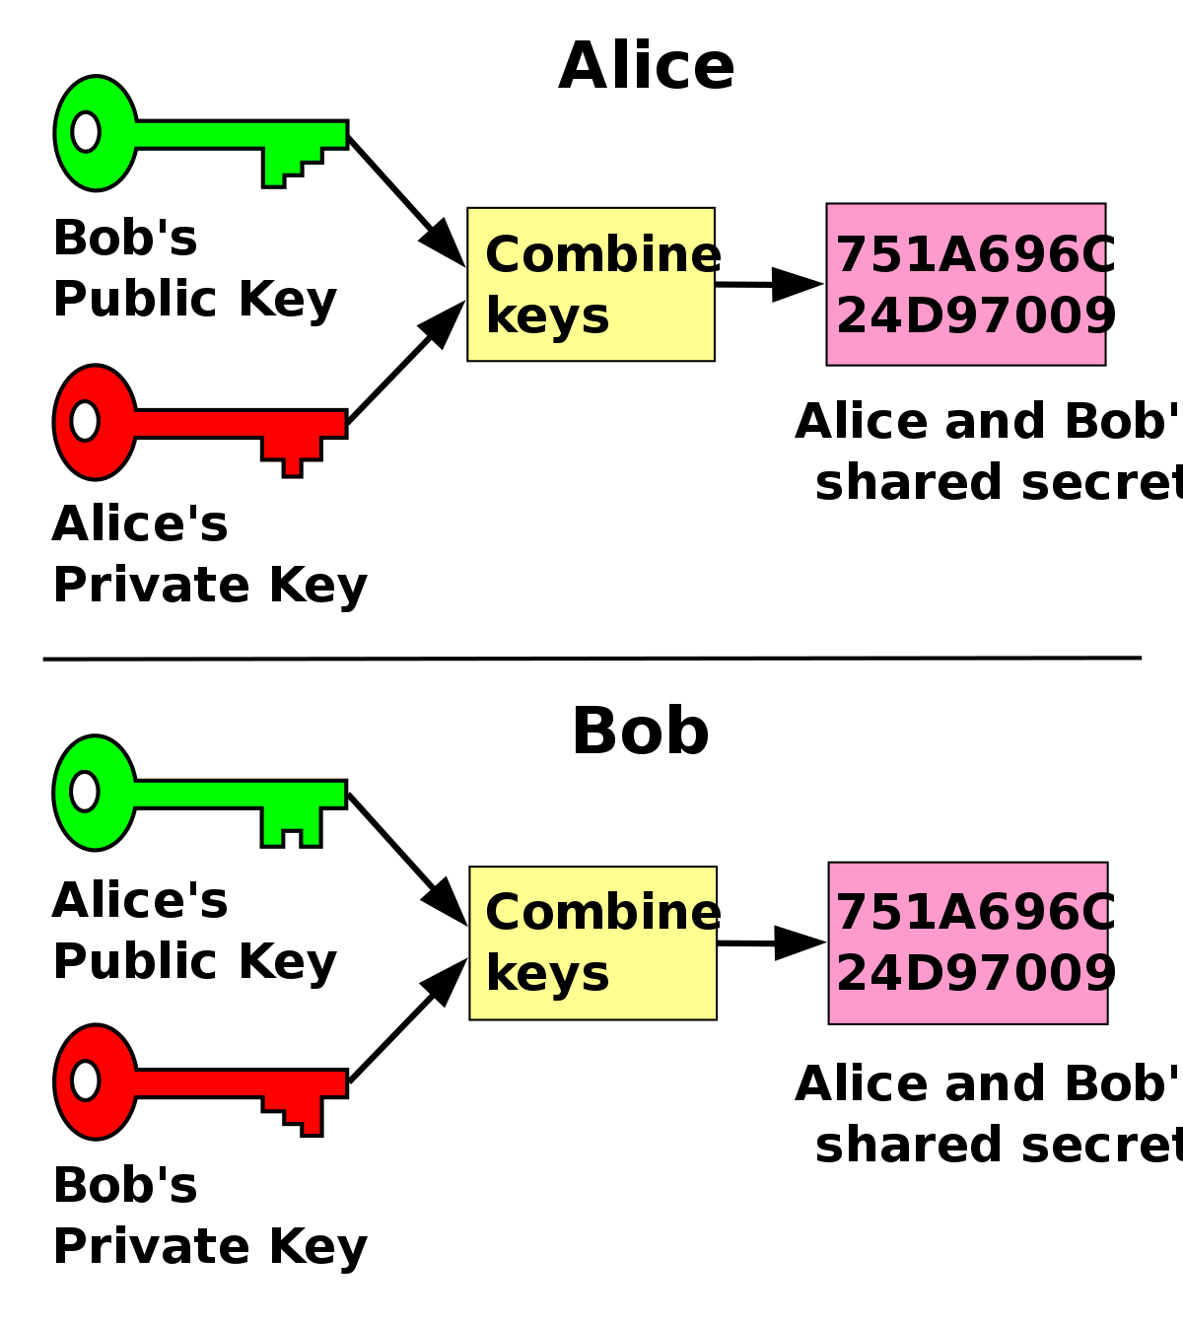
Diffie-Hellman Algorithm
Diffie–Hellman key exchange is a method of securely exchanging cryptographic keys over a public channel.
Diffie–Hellman key exchange establishes a shared secret between two person that can be used for secret communication for exchanging data over a public network.

Slide 5
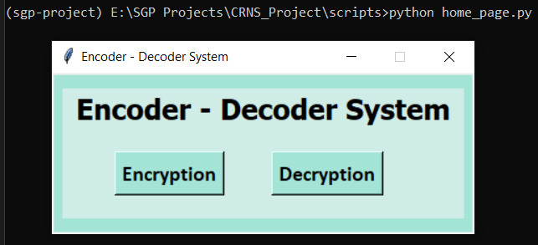
Project Definition
We have build cryptosystem to encode and decode secret text message using RSA and Diffie-Hellmen algorithm and public and private keys.

Slide 6
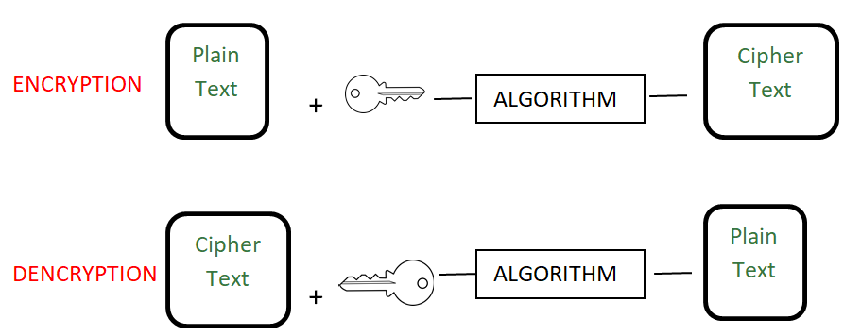
Flow chart
As we can see in the below image we will take secret message, keys and than after we will apply the RSA or Diffie-Hellman algorithm.
After that the message will be in the form of cipher text and send it to the receiver.
Now receiver will apply the extracting algorithm and known decryption key. The receiver will get the secret message from cipher text.

Slide 7
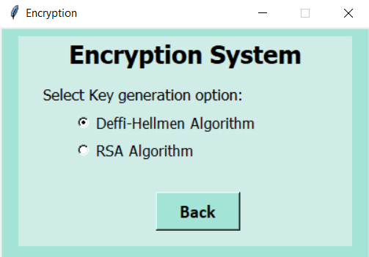
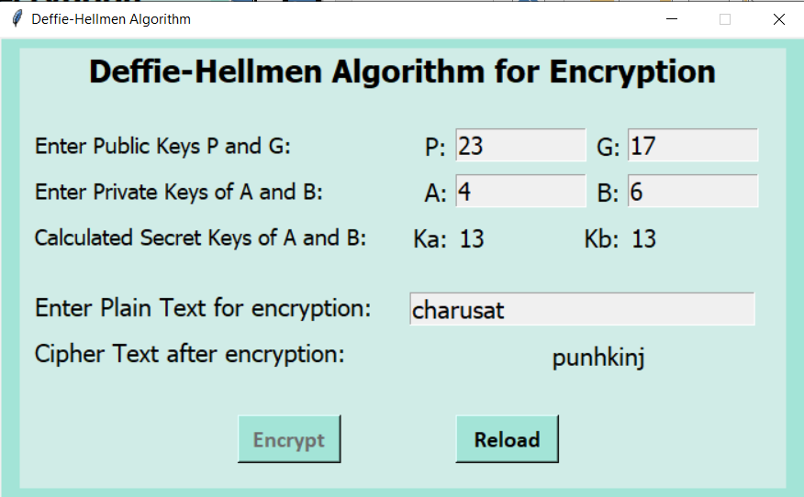
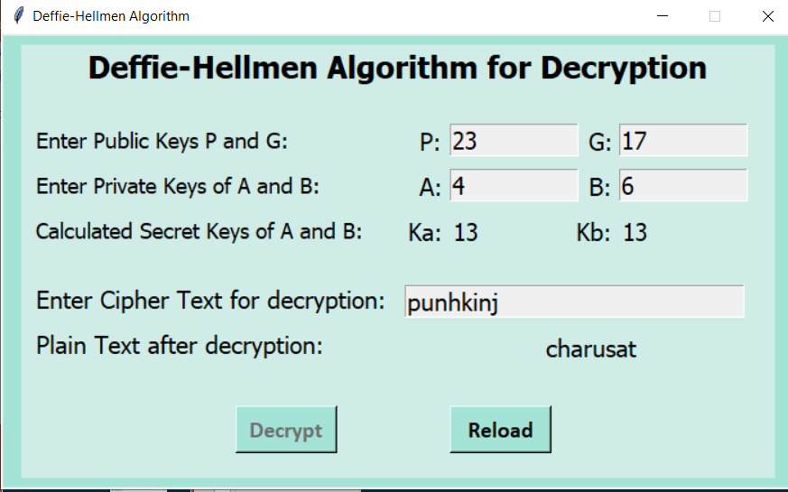
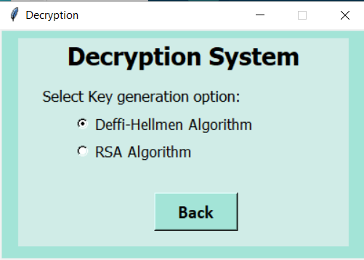

Slide 8
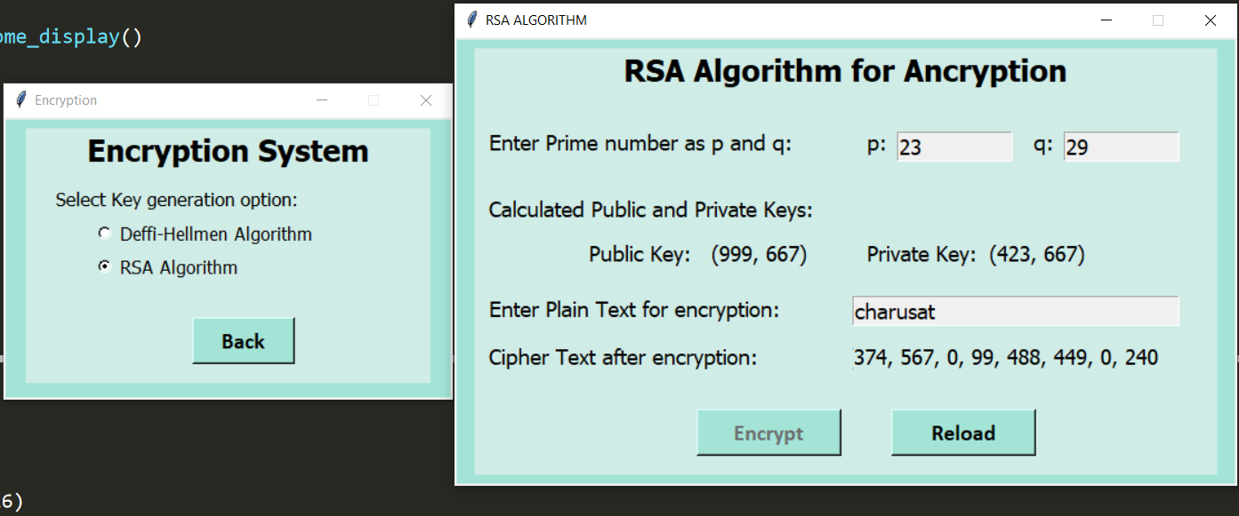
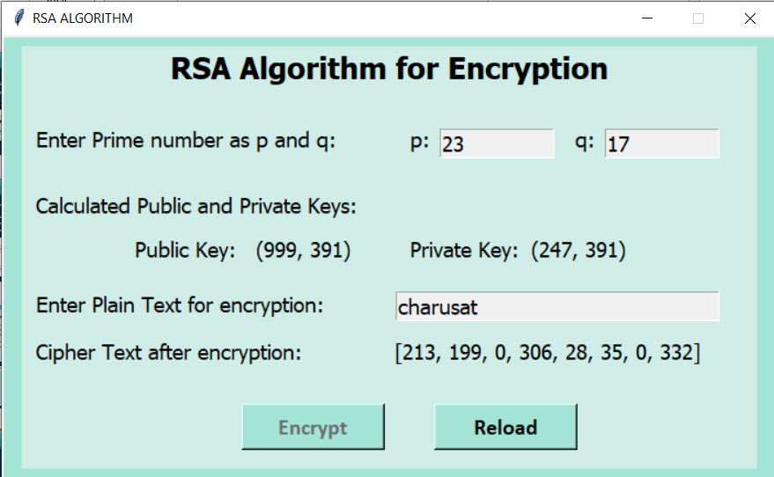
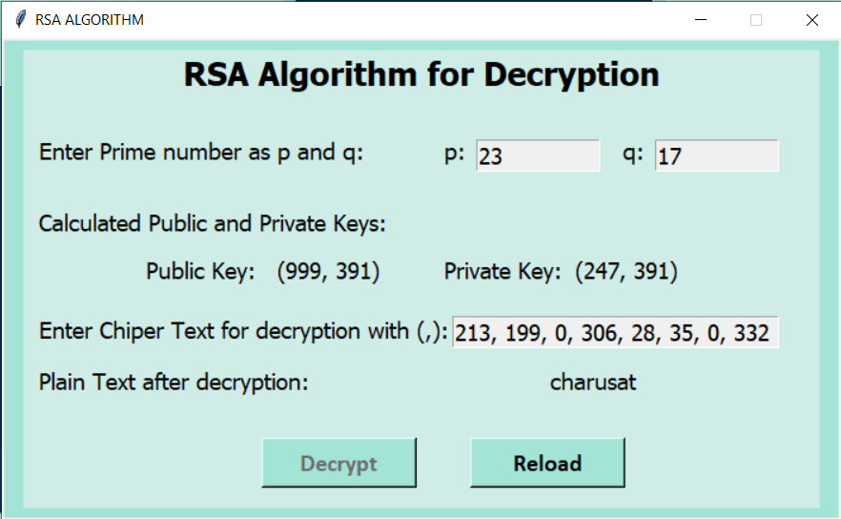
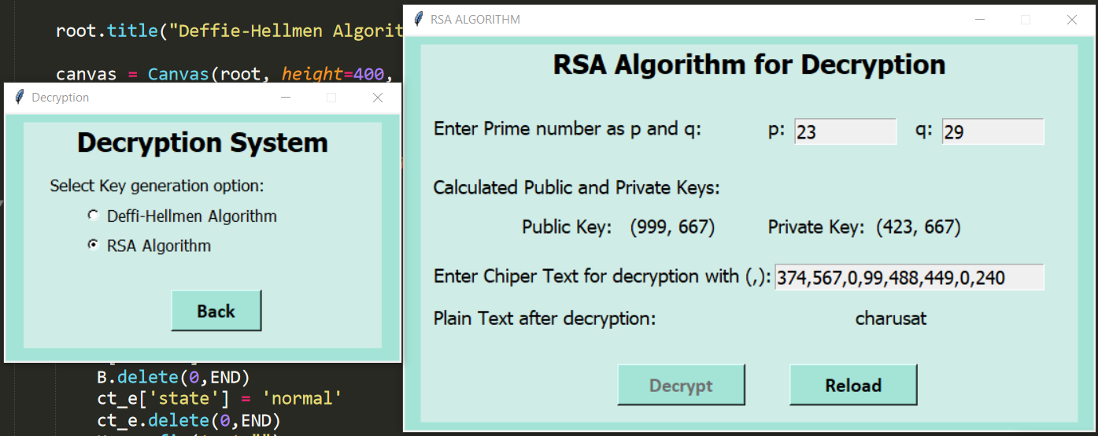

Slide 9
Future Scope
To make system which can directly send cipher text to the receiver just like we receive message and when receiver provide secret key he will get the secret message.
web application to encode and decode secret messages with more algorithms including Steganography.

Slide 10
References
https://www.edureka.co/
https://www.geeksforgeeks.org/rsa-algorithm-cryptography/
https://www.tutorialspoint.com/cryptography_with_python/cryptography_with_python_understanding_rsa_algorithm.htm
https://www.geeksforgeeks.org/implementation-diffie-hellman-algorithm/

Slide 11
Thank You

